Slide 1
CHAPTER 7- ENTERPRISE RESOURCE PLANNING SYSTEMS
Principles of Supply Chain Management:
A Balanced Approach

Slide 2
Learning Objectives
You should be able to:
  Describe an ERP system
  Understand the limitations of legacy MRP systems
  Understand why firms are migrating from legacy MRP systems to integrated ERP systems
  Understand the advantages & disadvantages of ERP systems
  Describe the various modules of an ERP system,
  Compare best-of-breed vs. single integrator ERP implementation
  Understand why many ERP implementations fail
  Understand how an integrated ERP system works

Slide 3
Chapter Seven Outline
Development of Legacy MRP Systems
  Materials Requirement Planning
  Manufacturing Resource Planning
Development of Enterprise Resource Planning (ERP) Systems
Rapid Growth of ERP Systems
Implementing ERP Systems
Advantages & Disadvantages of ERP
ERP Software Applications
ERP Software Providers

Slide 4
Introduction
Materials Requirement Planning (MRP) systems- first choice in the U.S. for planning & managing purchasing, production, & inventories.
By end of the 20th century, U.S. business was changing.
  Firms were building multiplant international sites,
  Executives spent more time dealing with international subcontractors, currencies, & languages.
  Existing MRP systems could not handle added tasks.
Enterprise resource planning (ERP) systems were made to replace legacy MRP systems & coordinate information requirements for purchasing, planning, scheduling & distribution in a complex global environment.

Slide 5

Development of Legacy MRP Systems
Legacy MRP systems which were implemented in the 1960s, 1970s & 1980s, describe an older information system at a production scheduling operational level within an organization.
  MRP systems lasted beyond their intended life span.
  Communication between legacy systems is limited.
  Visibility across functional areas is restricted.
  Lack analytical capabilities.

Slide 6
Development of Legacy MRP Systems- Cont.
Materials Requirement Planning (MRP) Process
  Uses information from bills of material, master production schedules, & inventories to compute planned order releases of dependent demand items.
  Links the internal operations of an organization, such as purchasing, production, inventory control & material planning.
  Does not, however, provide production or capabilities analysis, nor does it probe the impact of changes in production levels on financial results.
  Closed-Loop MRP- An attempt to further develop MRP into a more formal planning & control system, & was a natural extension of the MRP system.

Slide 7
Development of Legacy MRP Systems- Cont.
Manufacturing Resource Planning MRP II-
Was the next development of the closed-loop MRP system in which:
  Business & sales plans were incorporated.
  A financial function was added to link financial management to operations, marketing, & other functional areas.
MRP II now includes other functions of the organization.
Problems with MRP II:
  Primarily focuses on one unit’s internal operations.
  Lacks capability to link the operations of firm’s foreign branches.
  Lacks capability to deal directly w/supply chain members.

Slide 8
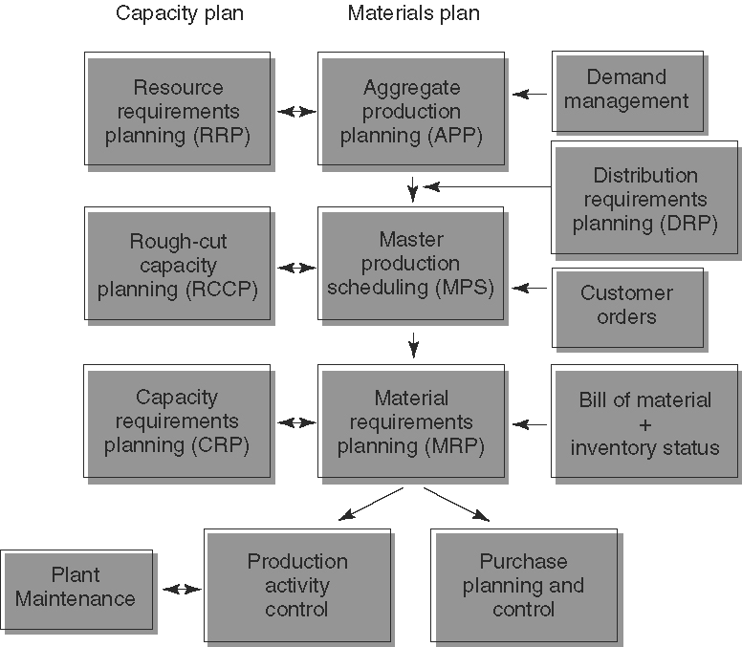
Development of Legacy MRP Systems- Cont.

Slide 9
Development of Enterprise Resource Planning
What is ERP and how did it come about?
  ERP system is an umbrella system tying a variety of specialized systems, (i.e., production & inventory, purchasing, logistics, HR, finance, accounting, customer relationship, & supplier relationship management).
  ERP utilizes a centralized & shared database system to tie the entire organization together in which information is entered once at the source & made available to all users.
  The emergence & growth of supply chain management, e-commerce, & global operations have created the need to exchange information directly with suppliers, customers, & foreign branches of organizations.

Slide 10
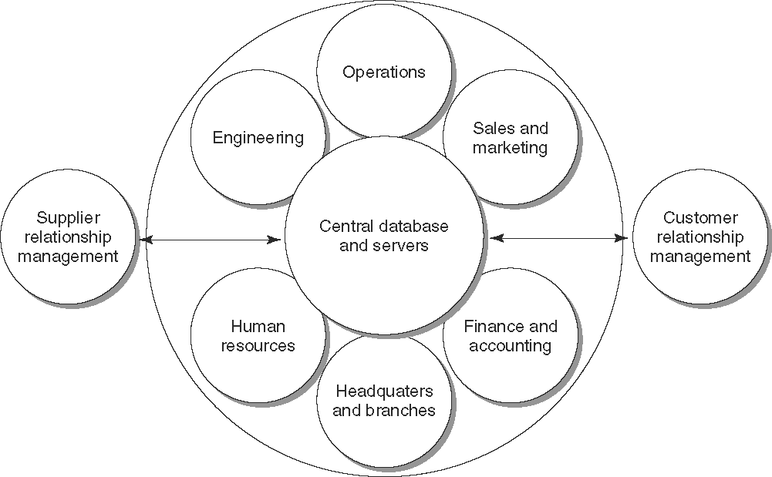
Development of Enterprise Resource Planning- Cont.

Slide 11
The Rapid Growth of ERP
The use of ERP has gradually spread from manufacturing to the service sector & has become commonly used in many university classrooms.
Contributing factors of rapid ERP growth:
  Firms replaced legacy MRP systems with efficient ERP systems to reduce costs & deal w/Y2K problem.
  Information systems that were previously off limits are now accessible to smaller organizations.

Slide 12

Implementing ERP Systems
Research analysts & industrial practitioners are still debating the usefulness of ERP, as well as the advantages & disadvantages of using best-of-breed solution and single integrator solution.
Best-of-breed- use best application for each supply chain function
  Problem: multiple databases may have to be used to link the multiple applications from different vendors.
Single integrator- applications from one vendor.
  Problem: A user’s processes must conform to the approaches used in the software logic. Conforming a company’s process to a software program is a radical departure from conventional practice.

Slide 13
Implementing ERP Systems- Cont.
Some observations on ERP Implementation
Some firms only implement modules deemed absolutely critical- Additional modules are added in a second phase.
Many implementations have failed due to:
  Lack of top management commitment
  Inaccurate & unrealistic inputs
  Lack of adequate resources
  Lack of proper training
  Lack of communication
  Incompatible system environment

Slide 14

Advantages & Disadvantages of ERP
Advantages
Uses single database & common software infrastructure
Communicates with supply chain members
Helps reduce supply chain inventories. Supply chain visibility leads to reductions of the bullwhip effect (buildup of supply chain safety stock inventories)
Standardizes processes & eliminates redundant resources while increasing productivity
Tracks employees’ time & performance
Integrates financial, production, supply,
& customer information.

Slide 15
Advantages & Disadvantages of ERP- Cont.
Disadvantages
Substantial capital investment is needed to implement the system. The average total cost of ERP ownership was $15 million.
Software is designed around a specific business model based on specific business processes. The adopting firm must change its business model & associated processes to fit the built-in business model designed into the ERP system.

Slide 16
ERP Software Applications
ERP consists of many modules that are linked together to access & share the same database.
Most ERP software providers design their products to be compatible with their competitors’ products. The most common ERP modules are:
  Accounting & finance
  Customer relationship management
  Human resource management
  Manufacturing
  Supplier relationship management
  Supply chain management

Slide 17

ERP Software Providers
SAP AG, a German firm, is the world’s leading ERP software provider & the world’s third-largest software provider.
Flagship product is known as R/3
Used in more than 17,500 firms in 120 countries and employs about 28,000 people in more than fifty countries.
In 1973 SAP launched R/1 software, R/2 in 1979, and R/3 in 1992. R/3 has been dominant ERP product for almost a decade.
In early 2003, SAP introduced my SAP ERP which includes support for corporate services, such as real estate & travel management.

Slide 18

ERP Software Providers- Cont.
Oracle is the world’s leading supplier of information management software, world’s 2nd largest software company, & serves over 13,000 customers.
Oracle’s strategy focuses on five principles: globalization, simplification, standardization, automation, innovation.
Five comprehensive product lines: Oracle9i Database, Oracle9i e-Business Suite, Oracle9i Application Server, Oracle9i Collaboration Suite, & Oracle9i Developer Suite.

Slide 19

ERP Software Providers- Cont.
People Soft-. Primary focus of the company has been to build client/server business applications. First product made in 1988 was an HR application.
Leader in the human resources application market serves customer around the globe.
J.D. Edwards- world’s leading developer of agile software. Has over 6,500 customer worldwide. Designs all of its software solutions to be open, scalable, & flexible.
In August 2003, J.D. Edwards was acquired by PeopleSoft.

Slide 20

ERP Software Providers- Cont.
Baan (of SSA)- possesses a workforce of approximately 2,800 employees. It is part of the Production Management division of Invensys PLC, Its ERP product consists of a framework of open, flexible, & easy-to-configure components that allow individual applications to be configured to different industry processes.
Baan provides application solutions to more than 15,000 customer sites worldwide.
iBaan solutions, includes Enterprise, Customer Relationship Management, Product Life Cycle Management, Supply chain Management, Business Intelligence, OpenWorldX, & Dynamic Enterprise Modeling.

